Slide 1
Kinetics with Python
Handling multiple data files with Python
CheckIn: 809296

Slide 2
Things you’ll need
CheckIn: 809296
VLE page: Introductory Skills and Practical 2 > PC Sessions > Temperature Dependent Kinetics (Python)
Five CSV files of Kinetic data from the VLE (download and unzip!)
This powerpoint (downloading it is best!)
Python scripts (test.py and plot.py) available at (also on VLE): https://chemtl.york.ac.uk/data-analysis-reporting/python/graphs
Download all of these into a folder on your M: or H: drive and open that folder in Windows Explorer. Make sure the .py and .csv files are in the same folder.
Google submission form

Slide 3
Graphs and calculations
Last PC session you made use of spreadsheets to carry out data analysis
Spreadsheets are useful tools for data visualisation and analysis, especially for one-off sets of data
However, carrying out repetitive analyses can be quite time consuming, even using templates
This session will look at using pre-written Python scripts to allow for bulk data processing

Slide 4
Python scripts
These scripts are just text files which contain instructions
We need to run these files using a Python interpreter
Usually need to run with arguments which provide information such as the files to analyse when the script runs
Later, we will edit variables in the scripts to suit what you want to achieve
Eg set axes labels, choose columns for x and y, whether to include a line of best fit
The script can be run on one file, or many files, and will process all the data in the same manner

Slide 5
Python terminology
Variable
Used to store things at one point in the script which can be used later
Comment
Lines prefixed with # are ignored by the script and are used for notes
Loop
Instructions which are repeated by the script: for something, do some function
Function
A set of instructions for the computer to execute (eg draw graph, label axes)
Libraries
Pre-written code which can imported into our scripts to provide common functions (eg plotting, maths functions, reading files, displaying windows)

Slide 6

Executing a script
Open the folder containing your python script in Windows Explorer
Open a Terminal: right click in the folder, and select “Open in Terminal”.
Check the ‘Working Directory’ is displayed in Powershell
Call the python interpreter and pass the script name and any arguments:
python script.py arguments

Slide 7
Test script
Download the test script (test.py)
This script should run correctly
python test.py
The script checks you have a working python environment with all the packages installed that we will be using
Run the test script first when working on a different computer to check the setup!
If this script won’t run, get help to fix your setup…
Is Python installed?
If you are on a campus machine, try another PC

Slide 8
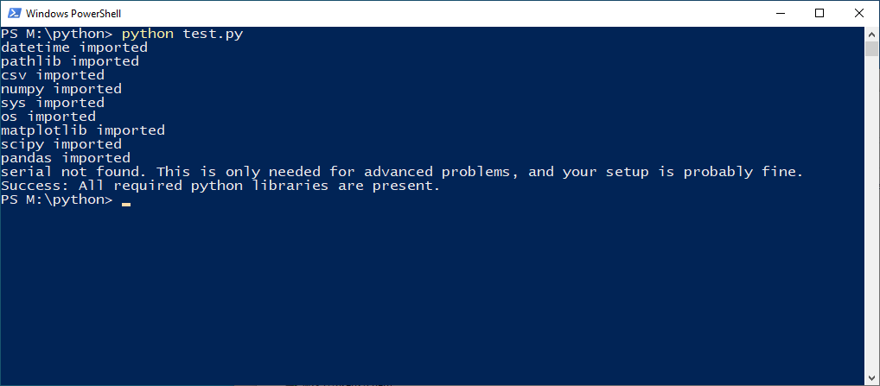
Test script

Slide 9
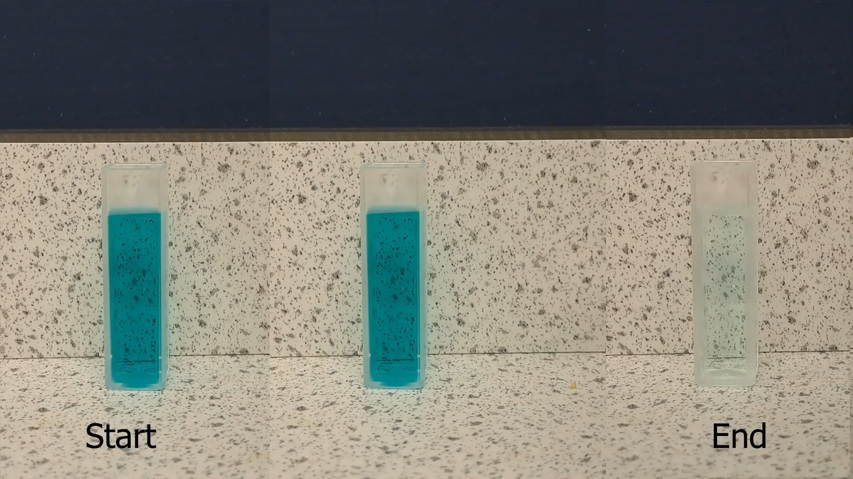


Pseudo-First order kinetics
Going to look at the temperature dependent kinetics for the bleaching of Brilliant Green dye
This is the same analysis you carried out before using spreadsheets
But we’re going to look at using Python so that we can carry out large amounts of data analysis with minimal effort

Slide 10
Steps we’re going to do
Plot the raw data for each run: abs v time
Create linearised plots: ln(abs) v time
Collate all the kobs values from the individual plots
Create an Arrhenius plot and determine the activation energy
Will get the settings right on one file first for each step
Then will run the same script to process all the files

Slide 11
Plotting a graph
Download the plot script and the CSV files from the kinetic runs
Start with running the script and passing an argument of one filename
python plot.py 20_deg_C.csv
The script should run and will create a graph from the file
We then need to look at how to improve the output to suit our analysis

Slide 12
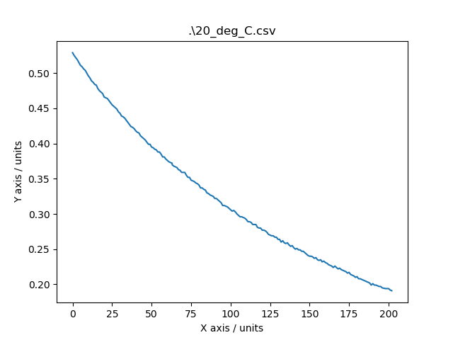
Plotting a graph

Slide 13
The script
Each script is a series of instructions in a text file
Comments are prefixed with a # and are ignored when the script is run
There are lots of options to configure in the script, and these are highlighted by the comments
Open the script up in a text editor (right click, Edit with Notepad++)

Slide 14
Axes labels
Need to set some appropriate axes labels with units
These come from the lines:
ax.set_xlabel("X axis")
ax.set_ylabel("Y axis")
Change the text between the quotes to set appropriate labels with units, following IUPAC style:
Axis label / units e.g. time / s
Edit and save the file, then rerun the script

Slide 15
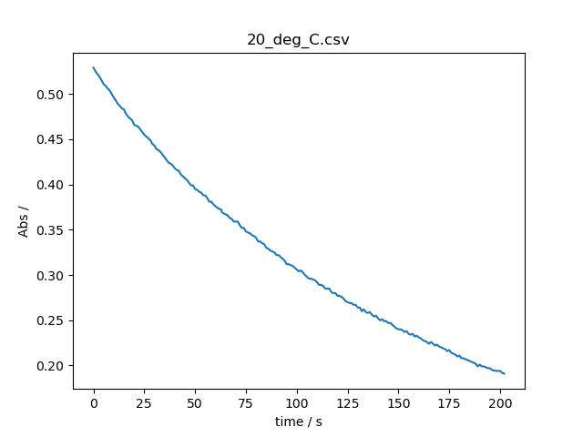
Axes labels

Slide 16
Setting limits
By default the axes ranges are automatically scaled to fit the data being plotted
This isn’t always desirable, such as for the y-axis here, where it doesn’t reach zero
The limits can be set in these lines if uncommented:
# ax.set_xlim([0,200])
# ax.set_ylim([0.0,1.0])
Need to take care when setting limits that suitable values are chosen for the entire dataset

Slide 17
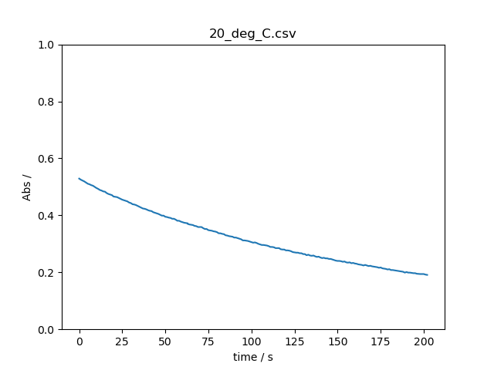
Setting limits

Slide 18
Setting output filenames
The script allows the setting of a custom file suffix
suffix = “”
This is blank by default - an empty string.
We can change this output as we use the script for different purposes
Right now we’re creating ‘raw data’ plots and we will go onto creating linearised plots
We can change the suffix to reflect the files we’re creating by adding something inside the quotation marks.
suffix = ‘_rawplot’

Slide 19
Raw data plots
Now ready to create raw data plots for the whole dataset
python plot.py *.csv
Once the files are created, we might choose to move these files out of the working directory to store as files we want to keep
E.g. put in a subdirectory that describes what these plots are

Slide 20
Changing output filenames
Next we’re going to start creating linearised plots of this data
Best to change the suffix to reflect this
suffix = ‘_linearised’

Slide 21

Data manipulation
In order to determine the pseudo-first order rate constants for each of the kinetics runs, we’re going to linearise the data:
We can set this manipulation to happen inside the script, so that the data gets manipulated before plotting
Eg we might need to :
Convert time in min to time in seconds: x = x*60
Convert °C to K: y = y + 273
Or in this case, take the natural log of y: y = np.log(y)

Slide 22
Data manipulation
In the data manipulation section we are going to uncomment the line to convert y before plotting:
# y = np.log(y)
We’ll also need to change out y-axis label to reflect the data now being plotted
And return the axes limits to automatic
We can then run the script on our 20°C CSV file

Slide 23
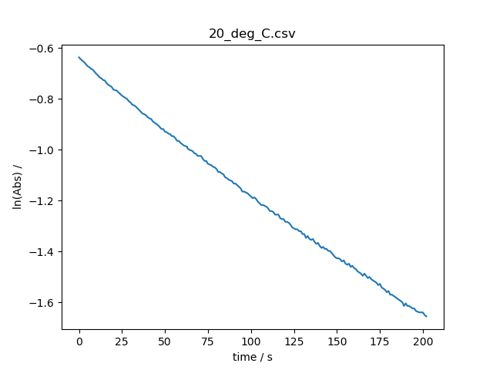
Data manipulation

Slide 24
Line of best fit
Now we have linear data, we want to include a line of best fit, and calculate the gradient and y-intercept
# Set fit to True to calculate a fit to the (possibly manipulated) data
fit = False
# Define the form of the function to be fit to the data (default: linear a*x+b)
def linear(x,m,c):
return m*x+c
Also enable legend so we know what things are:
#ax.legend()

Slide 25
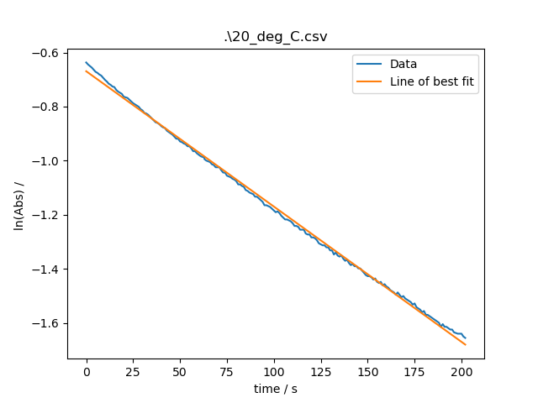
Line of best fit

Slide 26
Collating results
Often if we are performing linear regression, we want to collate the results from the individual sets of data
We can have these values collated into a new file, along with the filename of the input file
We need to turn on the collation:
# Set output to True to write the parameters of the line of best fit
# of every processed data file to a single external file.
output = False
And optionally change the filename:
output_fname = 'fit_parameters'

Slide 27
Collating results
Now ready to create linearised data plots for the whole dataset, complete with ‘fit data’ output file:
python plot.py *.csv

Slide 28
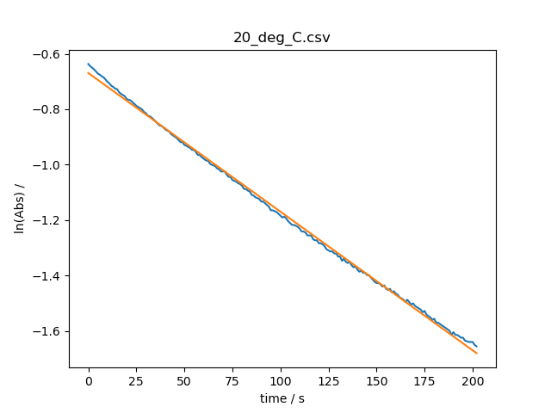
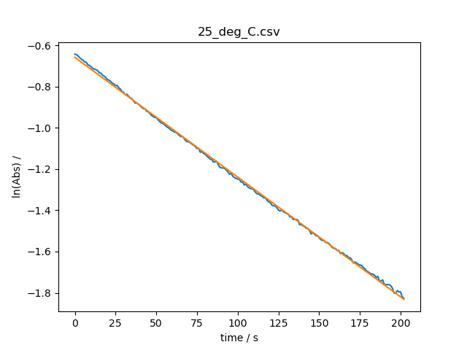
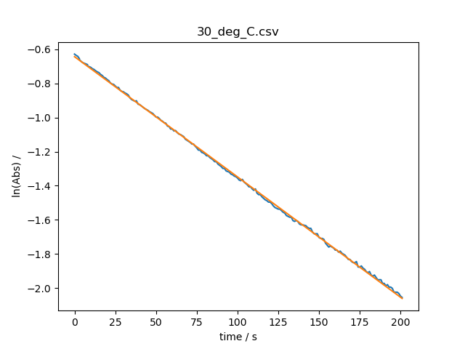
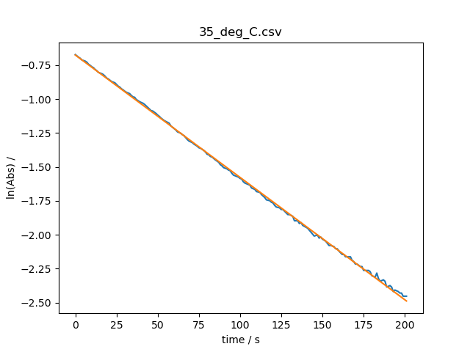
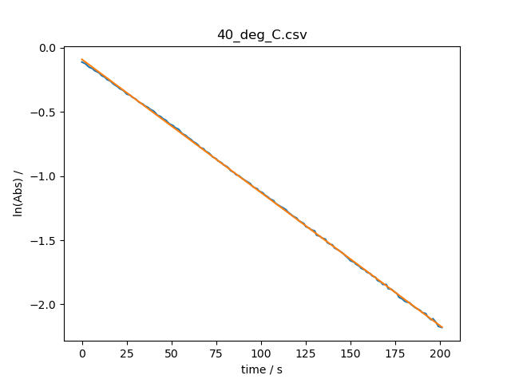
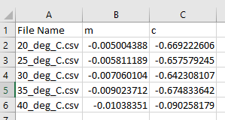
Collating results

Slide 29
Changing output filenames
Best to change the suffix before going onto the Arrhenius plot
suffix = ‘_arrhenius’

Slide 30
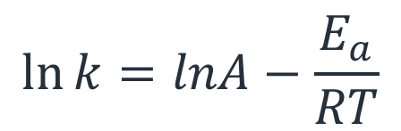
Arrhenius equation
The Arrhenius equation is the relationship for the temperature dependence of reaction rates and is given by:
Where:
k is the rate constant
T is the absolute temperature (in K)
A is the pre-exponential factor
Eₐ is the activation energy
R is the gas constant

Slide 31
Arrhenius plot
From a series of rate constants determined at different temperatures, this expression can be plotted in order to determine the activation energy and pre-exponential factor.
To make a plot using the data in our ‘fit_parameters’ file, we need to add the temperatures.
CSV files are just text files
Data is separated with a comma delimiter
Open the CSV file in Notepad++ and edit the values in the first column to just be the temperature (in °C)

Slide 32
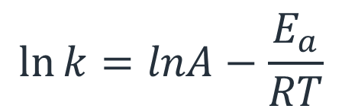
Arrhenius plot
Now it’s time to use the tools you’ve learned to make an Arrhenius plot (ln(k) v 1/T):
Load the data in the ‘fit_parameters’ file, modify the data manipulation section to make sure you plot the right variables, add the line of best fit.
For help with the data manipulation, try this list of functions.
You almost certainly won’t get this right first time, but that’s normal! Trial and error is how most programming works.

Slide 33
Setting data to plot
Our data from earlier has been formatted in the default way the script expects CSV data
X-values in the first column (index 0)
Y-values in the second column (index 1)
Single header row containing column headings
Not all data will be like this!
These settings can be configured:
data = np.loadtxt(fname,delimiter=",",skiprows=1)
x = data[:,0]
y = data[:,1]

Slide 34



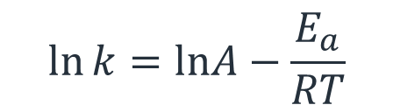
Arrhenius plot
Make sure you change:
suffix = ‘_ arrhenius’
You might lose data otherwise!
Goal:
Plot ln(k) v 1/T
Set axes labels with units
Include line of best fit
Include legend
Output m and c from the line of best fit
Equations:
The first set of plots used:
What are the m values we have in our ‘fit_data’ file equal to?
To find the true rate constant, we need:
The Arrhenius equation is:

Slide 35
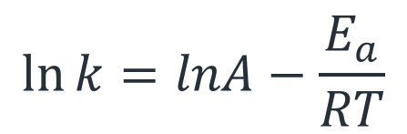

Arrhenius plot
Change the suffix to ‘_arrhenius’
The first column in ‘fit_parameters’ contains T in °C
The second column in ‘fit_parameters’ contains -k_{obs}
Convert T into K then to 1/T
Convert -k_{obs} into k using the relationship
[-OH] is 0.0185 M
Plot ln(k) against 1/T and a line of best fit. Output the fit parameters to a file, and convert from the gradient m to the activation energy E_{a}

Slide 36
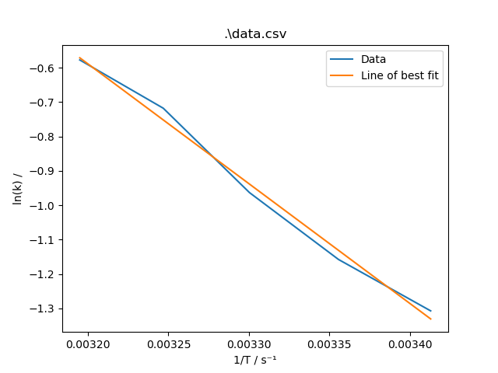

Arrhenius plot
Ea = 29 kJ mol⁻¹

Slide 37
Summary
The use of computer scripts allows repetitive analysis to be carried out easily, in a consistent manner
The collating of results automatically minimises the risk of errors from manual transcription
Python and Spreadsheets can both be very valuable tools in analysis

